Slide 1
Name :Suhani vyas. and Rajveer singh chouhan. Submitted to :mrs madhuri gupta mam.
.

Slide 2
B -Tree and B+ Tree
Topic:

Slide 3
B Tree-
A B tree is a self balancing mulitway search tree .
Instead of each node having just two children , nodes can have many children .
It is used in database and file systems to store large amounts of data efficiently on disks .

Slide 4
Key points of B tree ->
For order n , each node can have at most n children.
Each node (except root) has at least m/2 children.
All leaf nodes are at the same level.
Each node has keys between [ (m/2)-1 and m-1 ] keys.

Slide 5
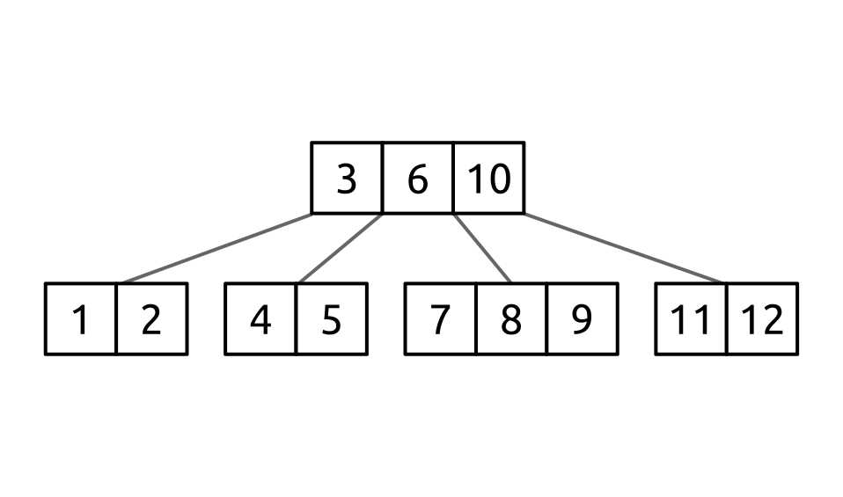
Structure of B tree

Slide 6
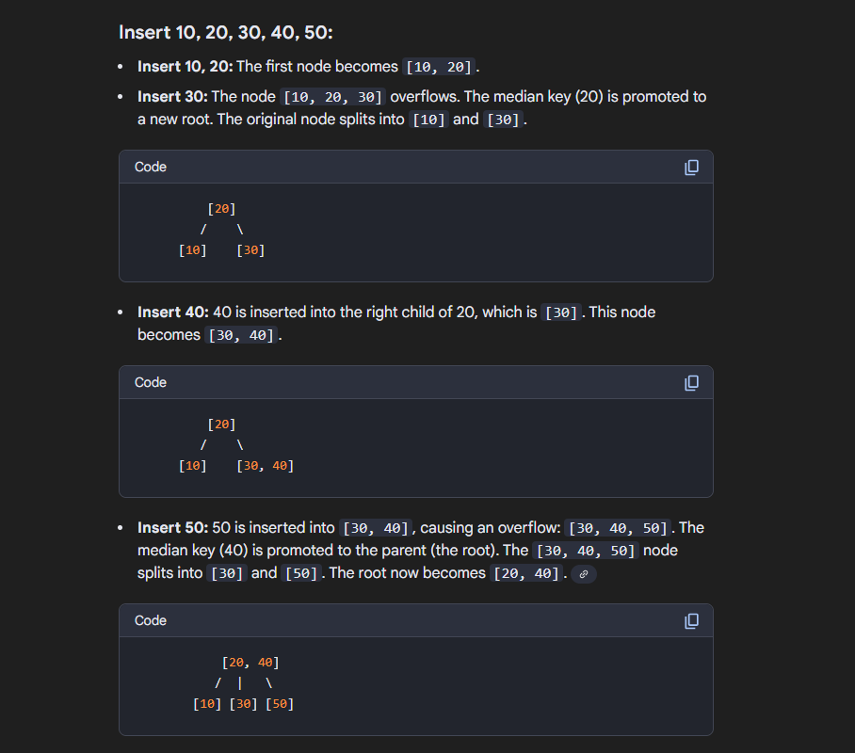
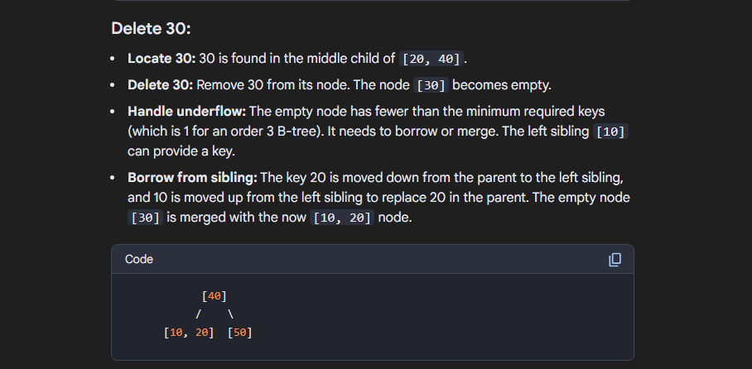
Numerical example of B tree -

Slide 7
B + tree-
A B + tree is a extension of B tree .
All data values are stored only in leaf nodes.
Internal nodes only store keys .
Leaf nodes are linked together for fast sequential access.

Slide 8
Properties of B+ tree
Every node is at the same depth from the root .
In B+ tree , the internal nodes do not store the actual data ,only keys and pointers to child.
For internal nodes each should have at least [m/2] children and at most m children (where m is maximum children allowed ).
For leaf has at least minimum number of keys m/2 , and at most a maximum (m-1) keys .

Slide 9
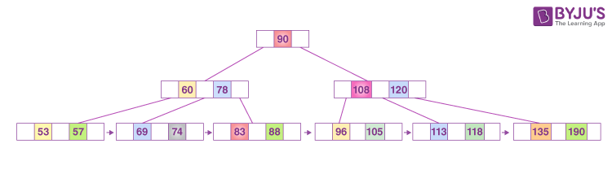
Structure of B+ tree->

Slide 10
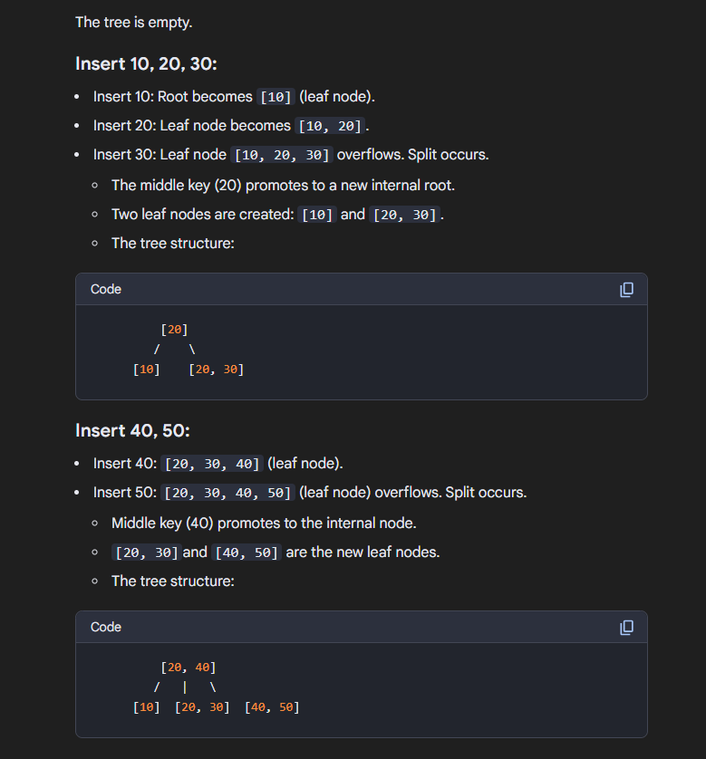
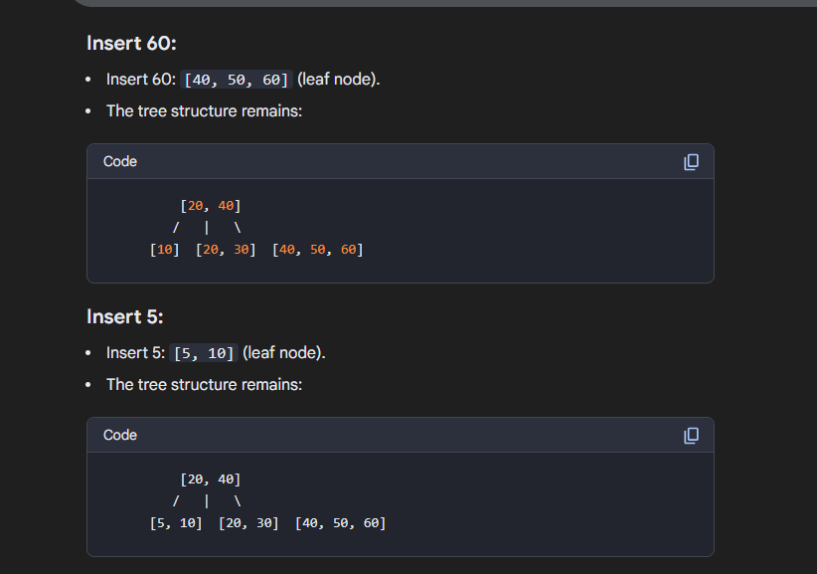
Numerical example of B + tree -

Slide 11
Difference between B-Tree and B+ Tree
B – Tree
B+ Tree
Data are stored in both internal and leaf nodes.
Leaf nodes are not linked.
Keys are not repeated.
More complex structure since data is in all nodes.
Data are stored only in leaf nodes, Internal nodes store only key.
Keys in internal nodes are repeated in leaf nodes.
Leaf nodes are linked together.
Simpler structure for searching as data is only at leaf level.

